Slide 1
Learning Robust Representation of ASM code : Generative Pre-training Perspective

Slide 2
1. asm2vec
Jointly learn function, assembly operation, operand, using gradient decent
→ Learning “what is in the middle”

Slide 3
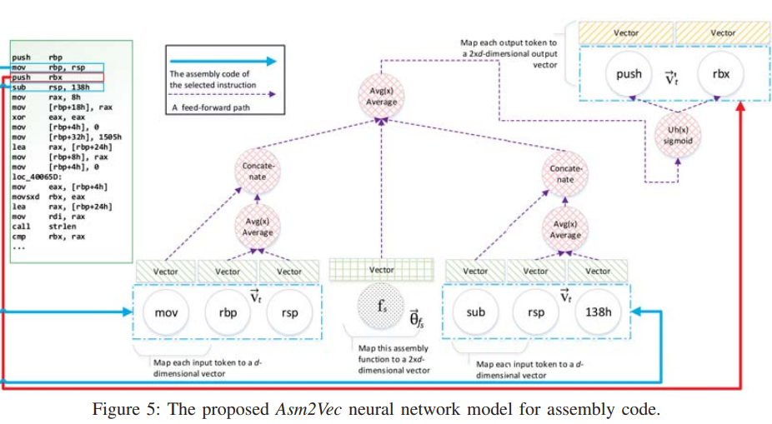

Slide 4
1. Cons
Suffers from federated, continual learning
Query estimation is iterative & gradient based (Not fast!)
Linear model

Slide 5
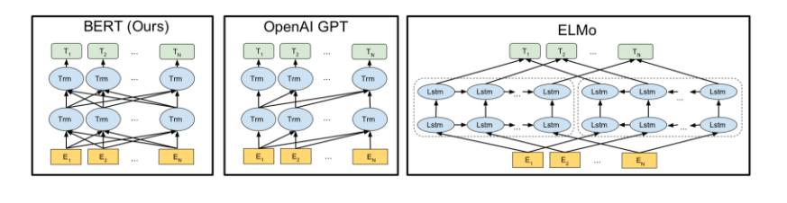
2. NMT, BERT, GPT
NLP(transformer models) had a huge boom…
→ Manages lack of labels by self-prediction

Slide 6
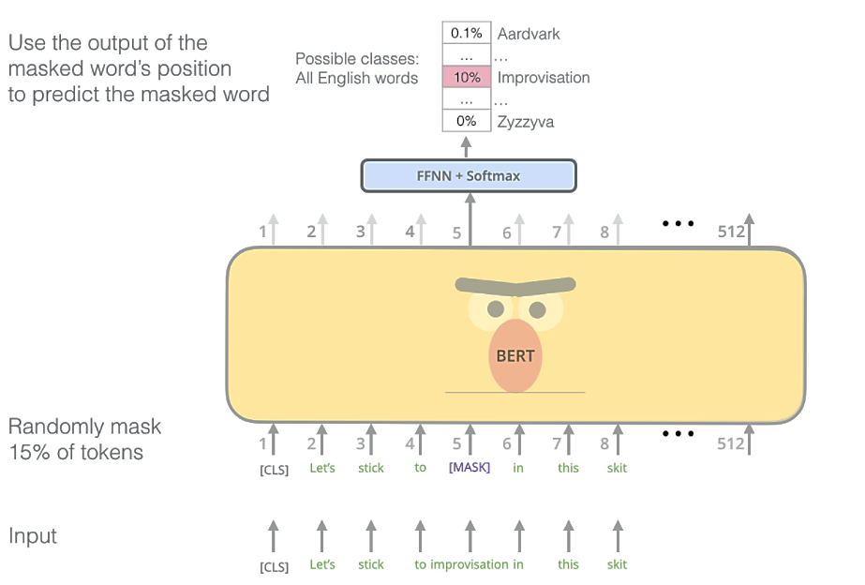
2. Masked Language Modelling
Representation Learning by self-supervision task

Slide 7
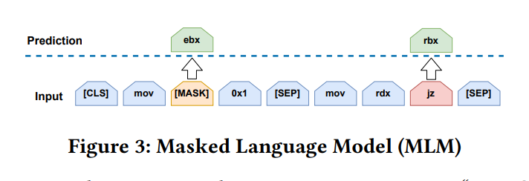
3. PALMTree
Use of Bidirectional Denoising task for assembly

Slide 8
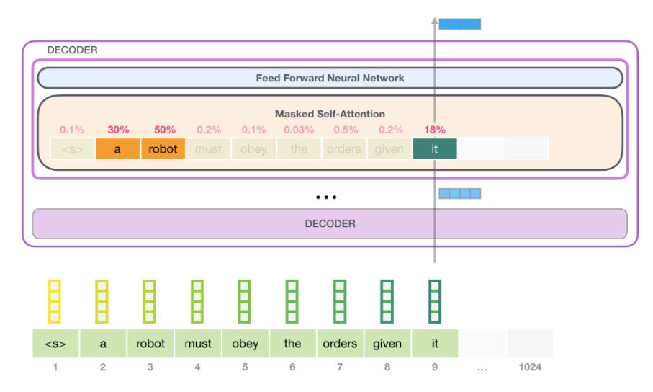
4. Generative Pre-Training
Next Token Prediction

Slide 9
Needs to learn representation by self-prediction (self-supervision)
Widely used task → Denoising task, Next Token Prediction
word2vec uses fixed position token prediction task, (function wise) → asm2vec
BERT uses denoising task → PALMTree
GPT uses Next Token Prediction → …?

Slide 10
5. Method
ASM source
Normalization,
Tokenization
Binary
Representation
Train GPT

Slide 11
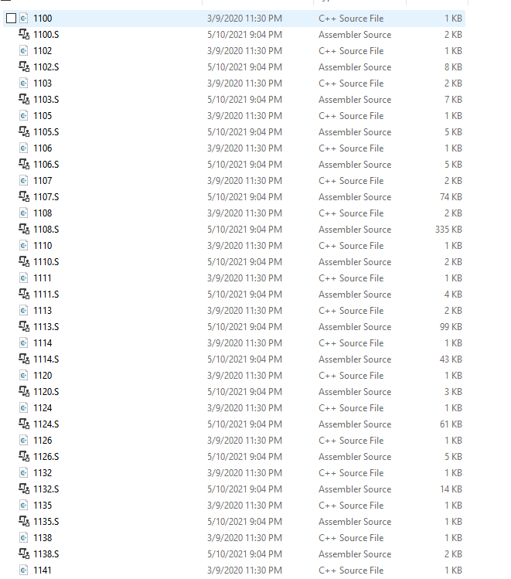
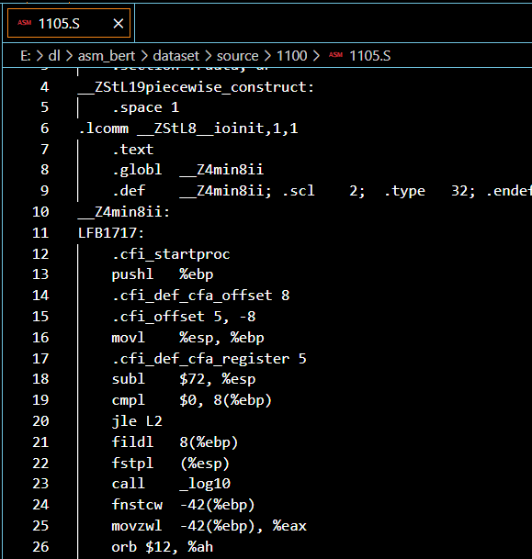
1. Decompiling (gathering asm)
Tried BinKit, but currently no IDA…
Gathered baekjoon codes, compiled
To Intel ASM

Slide 12
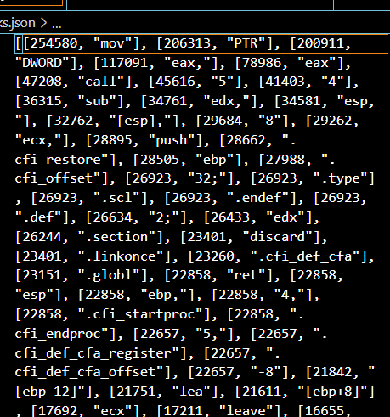
2. Tokenizing
Used top-k assembly code blocks → making dictionary of tokens

Slide 13
3. Training GPT
Used pytorch 1.8.0, trained on Nvidia 1070ti
Trained for 20 min, 32 batches, 128 token window…
172, 170, 162, 107, 25, 116, 552, 117, 60, 48, 7, 678,
113, 1183, 25, 27, 26, 48, 45, 29, 22, 20, 23, 19,
18, 21, 34, 14, 16, 38, 12, 17, 36, 39, 32, 31,
37, 6, 8, 10, 120, 2, 1, 86, 43, 3, 2, 1,
71, 41, 9, 81, 2, 1, 11, 24, 13, 4, 5, 8,
10, 7, 3, 2, 1

Slide 14
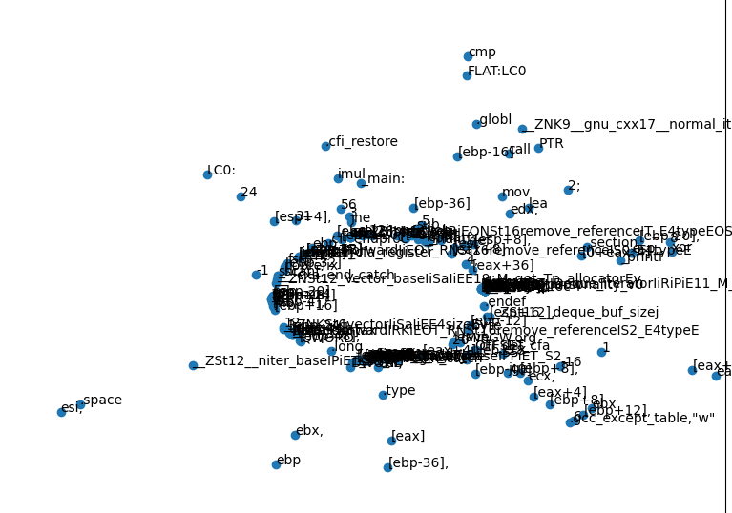
3. Token Embedding TSNE

Slide 15
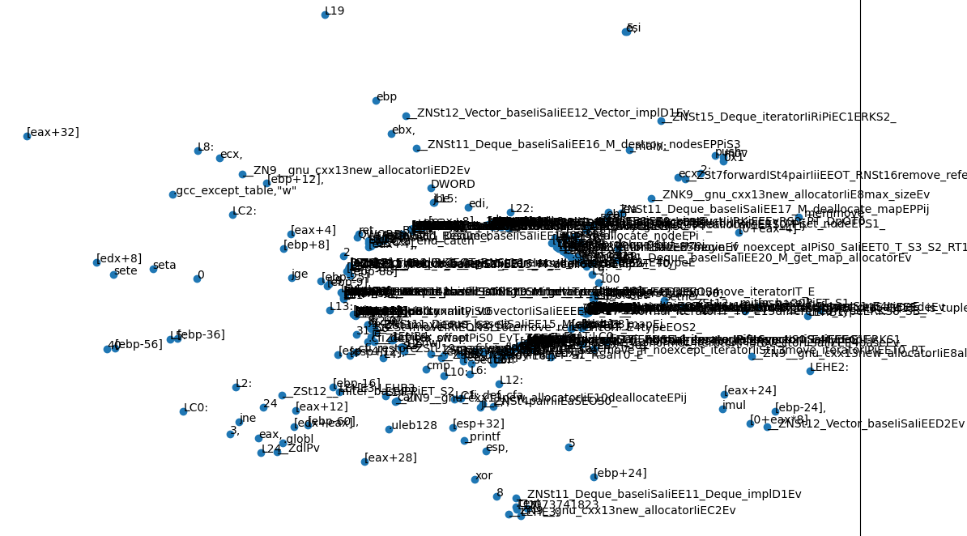
Top 400

Slide 16
Thank you

